Slide 1



What Half a Million Complaints Reveal About America’s Financial Pulse
Qasim Malalla

Slide 2
Introduction
Every complaint represents someone who felt wronged by the financial system. But while companies see tickets and cases, we see a data story waiting to be told. Over 500,000 complaints, some detailed, some brief reflect patterns that go far beyond individual frustration. They expose who’s struggling, what’s broken, and where action is needed. The problem isn’t just the complaints, it’s that we’re not listening to them deeply enough.

Slide 3
Introduction
Consumer Submits a Complaint
CFPB Reviews and Routes the Complaint
Company Responds
Consumer Reviews the Response
Consumers file a complaint through the CFPB’s website, describing the issue and selecting the company involved.
The CFPB screens the complaint and forwards it to the relevant company for direct response.
Companies are required to review and respond to the complaint within 15 days, addressing the issue or explaining their position.
Consumers can read the company’s reply and indicate whether the issue was resolved to their satisfaction.
CFPB : Consumer Financial Protection Bureau

Slide 4




Aims & Goals
Understand Consumer Complaints
Evaluate Product and Issue Prevalence
Benchmark Companies Performance
Enable Data-Driven Decision Making
Identify how consumer complaint volumes fluctuate over months, weekdays, and years to reveal underlying behavioral and systemic patterns.
Analyze the distribution of complaints across financial products and sub-products to spotlight which services generate the most dissatisfaction or confusion.
Compare companies based on volume of complaints, response timeliness, and resolution consistency to highlight leaders and laggards in consumer protection.
Translate complaint patterns into actionable insights that can support smarter regulation, internal audits, and strategic improvements in customer experience.

Slide 5

About the Dataset
Total Complaints
500,000
Total Companies
2904
Submission Method
Web
Location
United States
Period
2020-2024

Slide 6
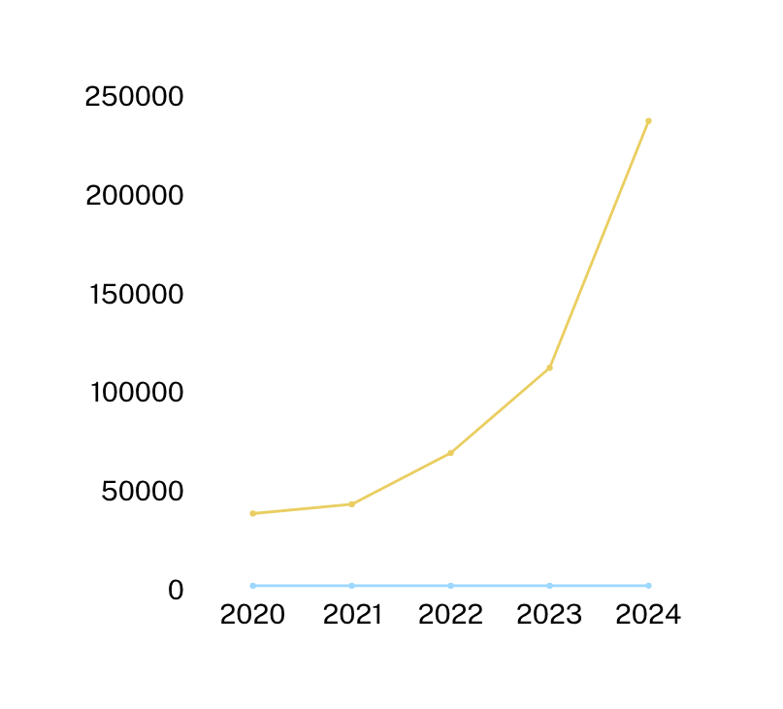
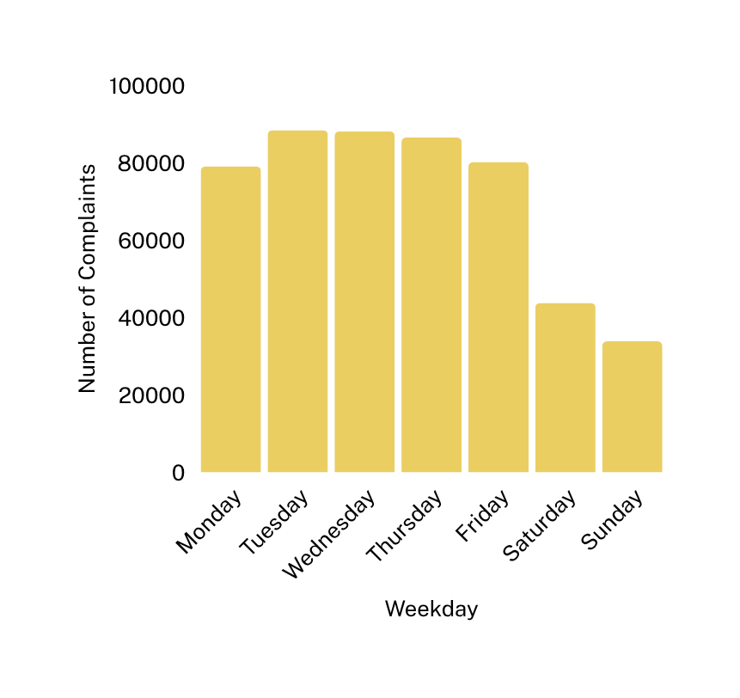
When Are Complaints Filed?

Slide 7
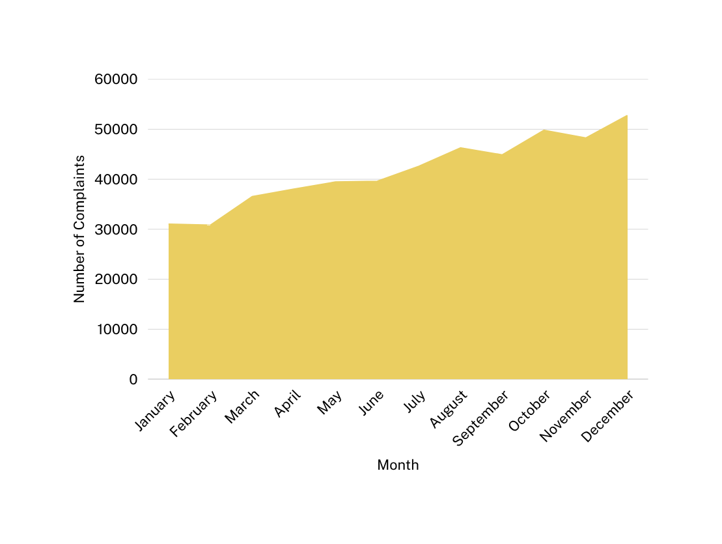
When Are Complaints Filed?

Slide 8
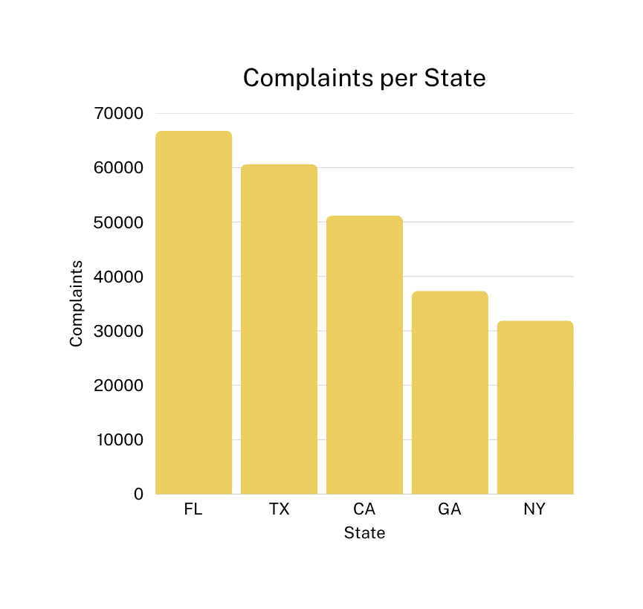
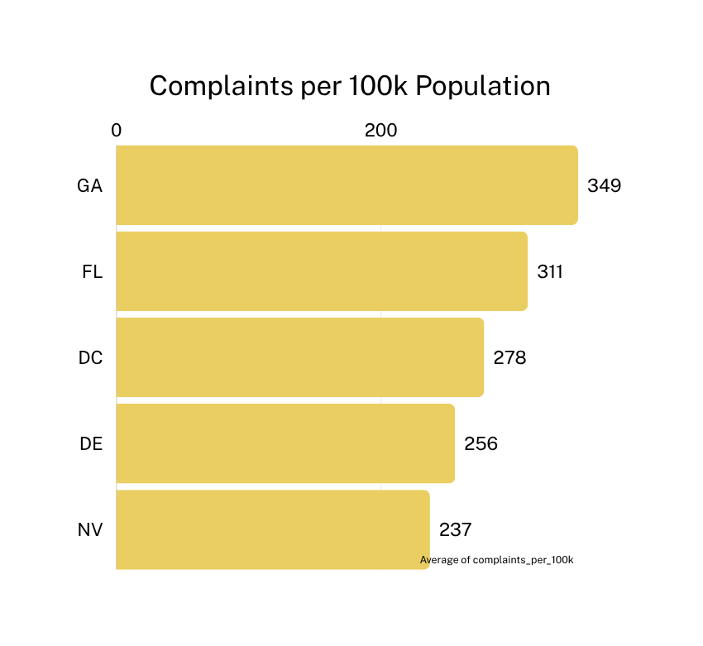
Where complaints come from?

Slide 9
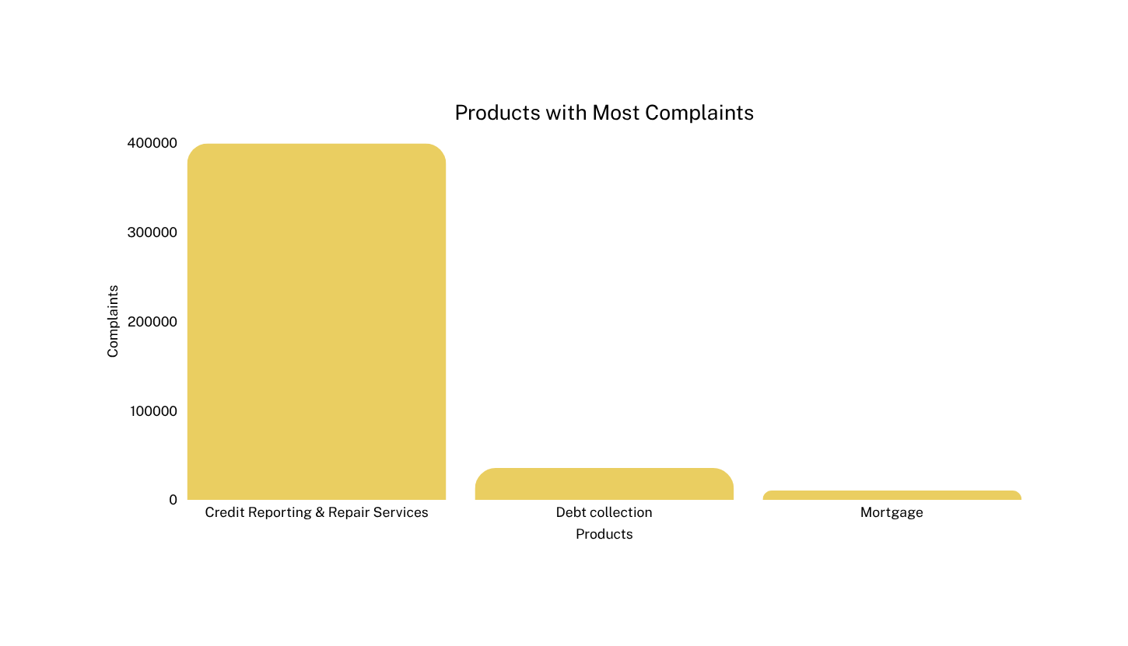
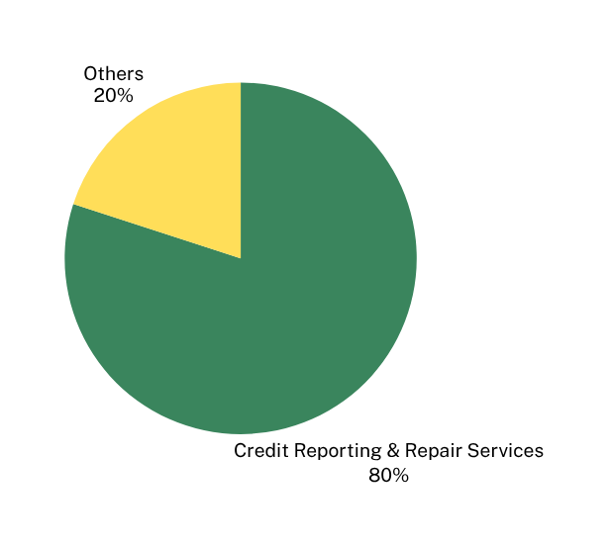
What people are complaining about?

Slide 10
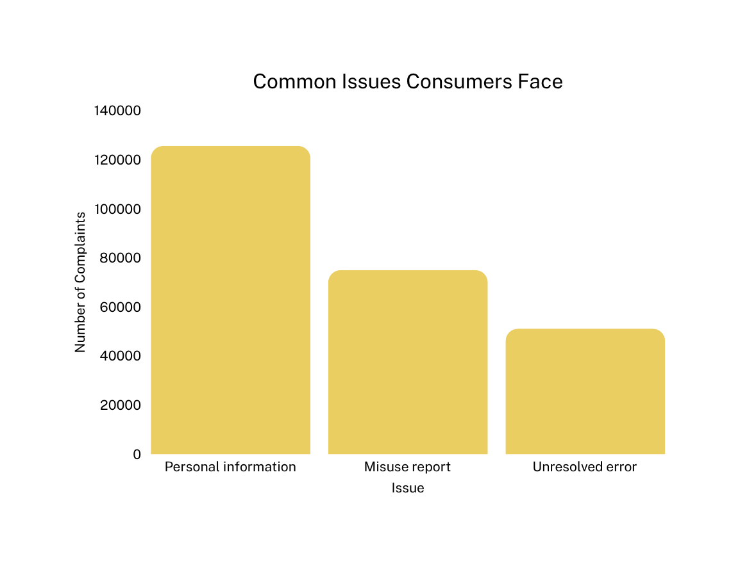
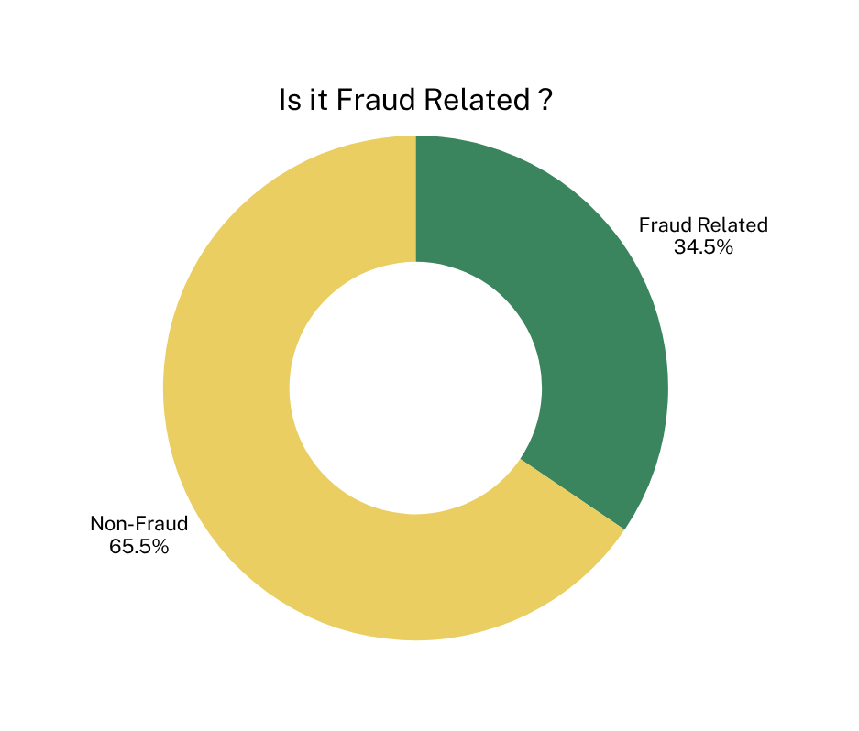
What people are complaining about?

Slide 11
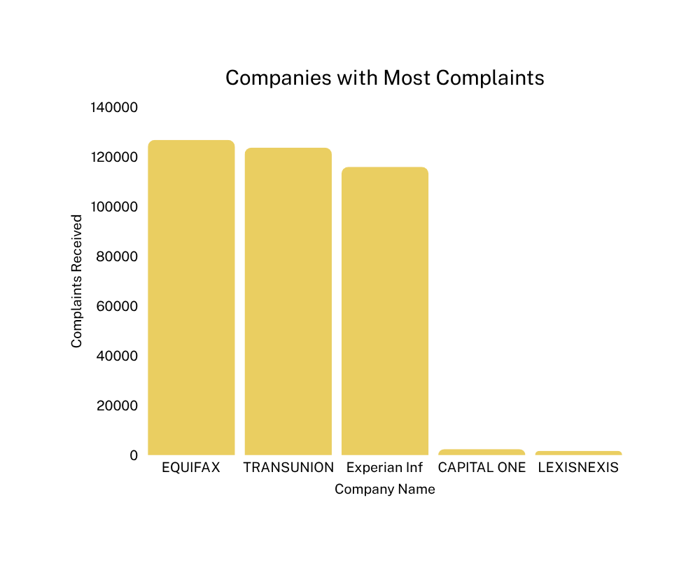
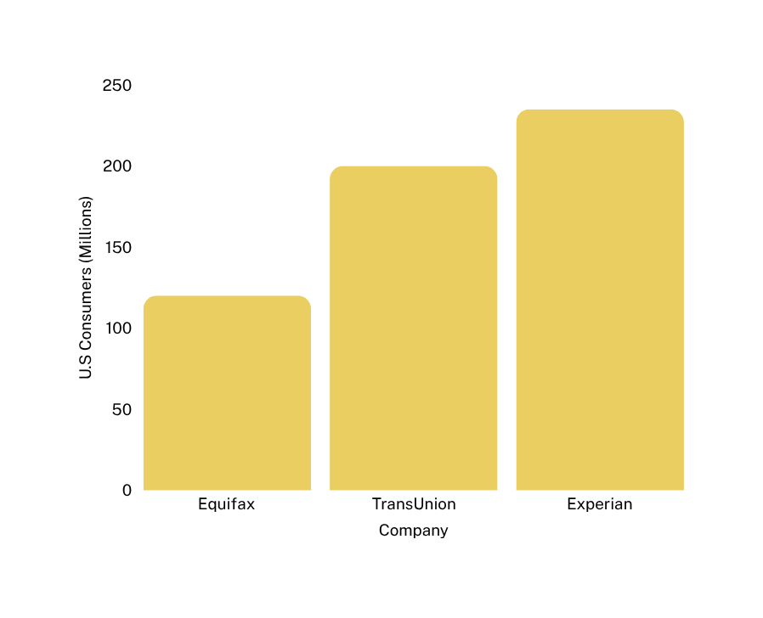
Companies Performance

Slide 12
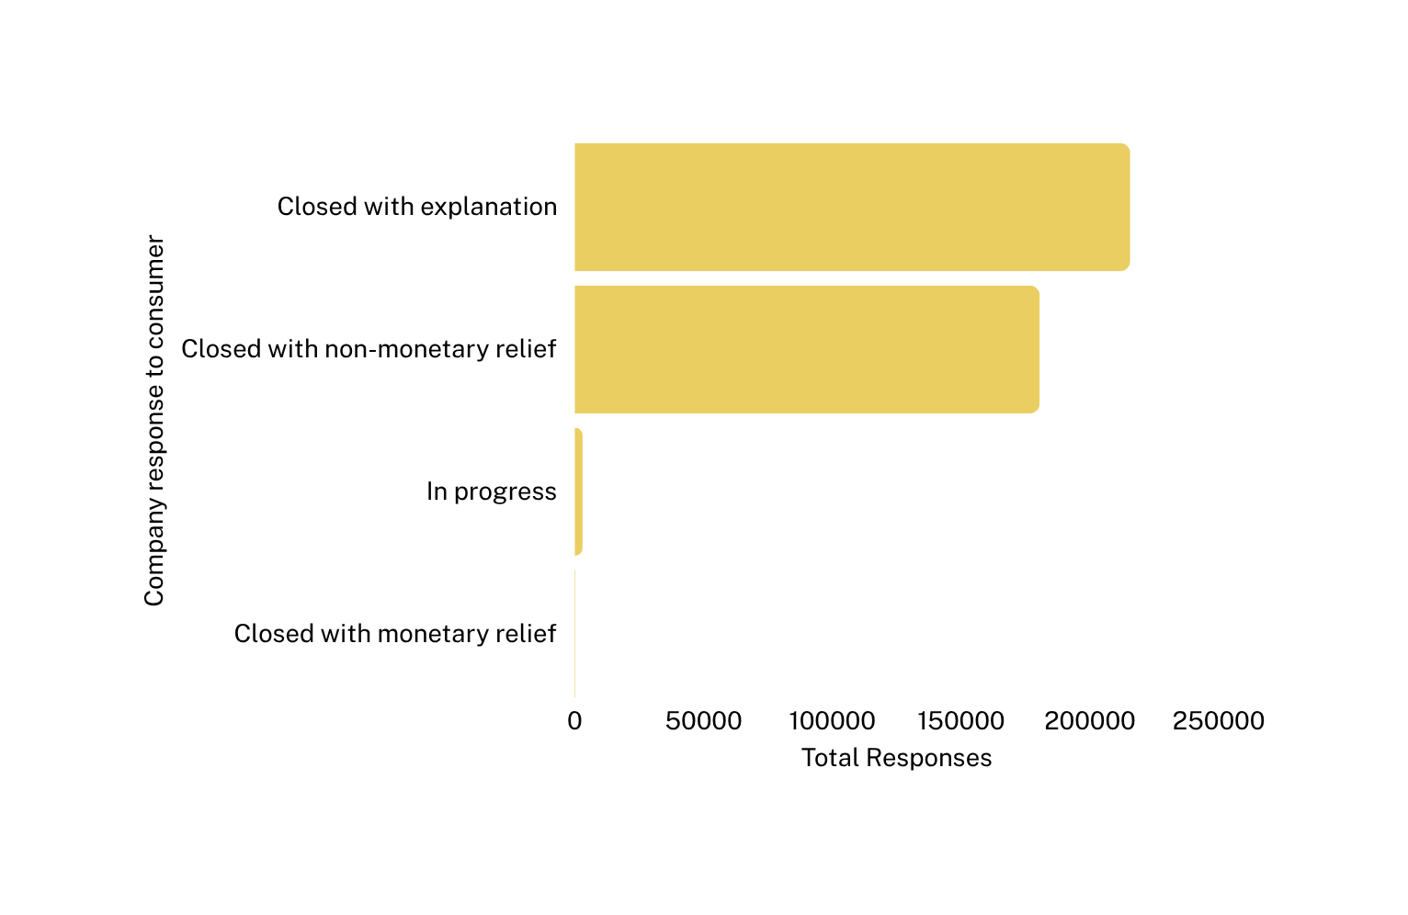
Companies Response

Slide 13



For Regulators
For Consumers
Transparency in complaint data empowers individuals to make informed choices and hold institutions accountable.
Complaint trends offer early warning signals for emerging financial risks and systemic failures.
Why This Matters
For Companies
For Researchers
Data-driven benchmarking can highlight service gaps and opportunities for proactive customer experience improvements.
The dataset reveals long-term patterns in financial behavior, trust, and inequality rich for academic and policy study.

Slide 14
Recommendations
Strengthen Q4 Operational Preparedness
Evaluate Product and Issue Prevalence
Modernize the Entire Complaint Lifecycle
Establish a National Complaint Intelligence Framework
Preemptive surge staffing for support and dispute resolution during Oct–Dec.
Audit billing and fraud protocols ahead of Q4 to reduce preventable errors.
Mandate clearer consumer-facing dashboards to verify and dispute reports.
Introduce response time standards and escalation pathways for identity theft and credit errors.
Move beyond intake portals: build end-to-end complaint platforms with live status tracking.
Integrate AI-assisted triage + human escalation, especially for complex issues.
Create a centralized intelligence hub to continuously monitor complaint trends across products, regions, and companies.
Use complaint data not just for enforcement, but for policy design, public education, and innovation incentives

Slide 15
Thank you very much!

